Slide 1
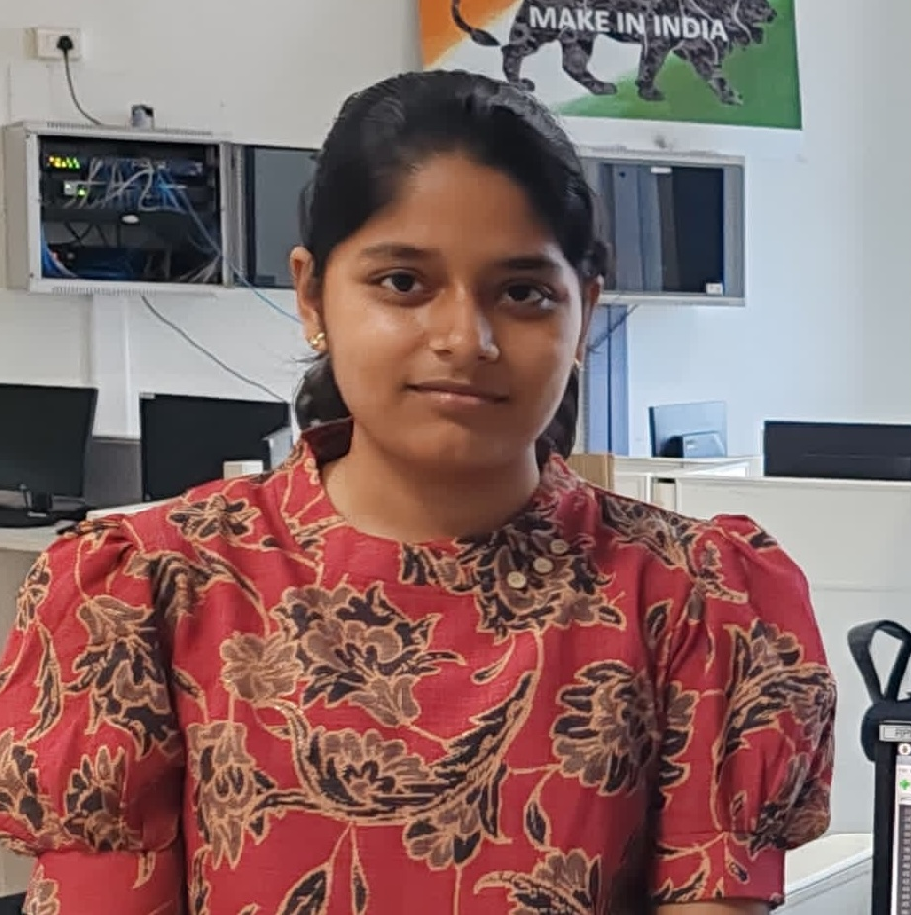


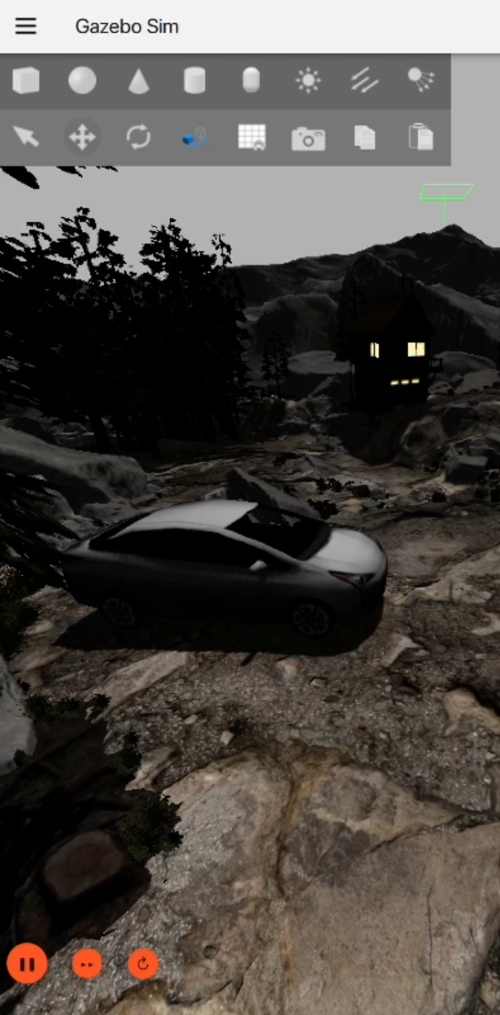



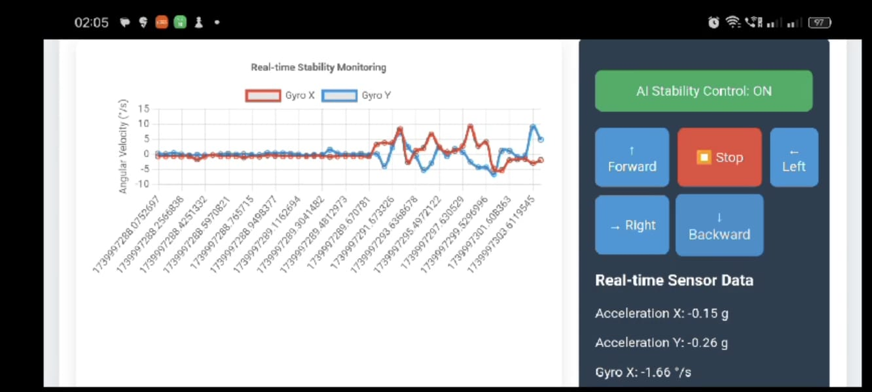
Concept title :
Automatic compensation of torque gaps for an electrical vehicle on a rough terrain
Indian Institute of Information Technology, Design and Manufacturing, Kancheepuram
Janani K.S
Ujjwal Raj
3. Vedhava Krishna
Challenge statement :
Electric vehicles often face torque gaps during gear shifts and speed changes, affecting stability, comfort, and performance—especially on rough terrains. The challenge is to develop an AI model that learns and compensates for these torque variations in a 4-wheel drive system. Additionally, real-time vehicle stability should be visualized using plane plots to monitor and improve performance across different terrains.
Concept description :
Our prototype presents an AI-driven adaptive torque control system for electric vehicles on rough terrains. We simulated EV dynamics in Gazebo and collected IMU sensor data under challenging conditions. A neural network, trained on this data, predicts optimal motor duty cycles to adjust torque for each wheel, improving traction, stability, and efficiency. The system runs on a Raspberry Pi with real-time control and a web interface for manual and AI-assisted stability monitoring.
Team PID #
3271

